Slide 1
Predictive Prioritization at the Edge
Jonathan Janos Senior Solution Engineer, MapR Federal
February 2019

Slide 2




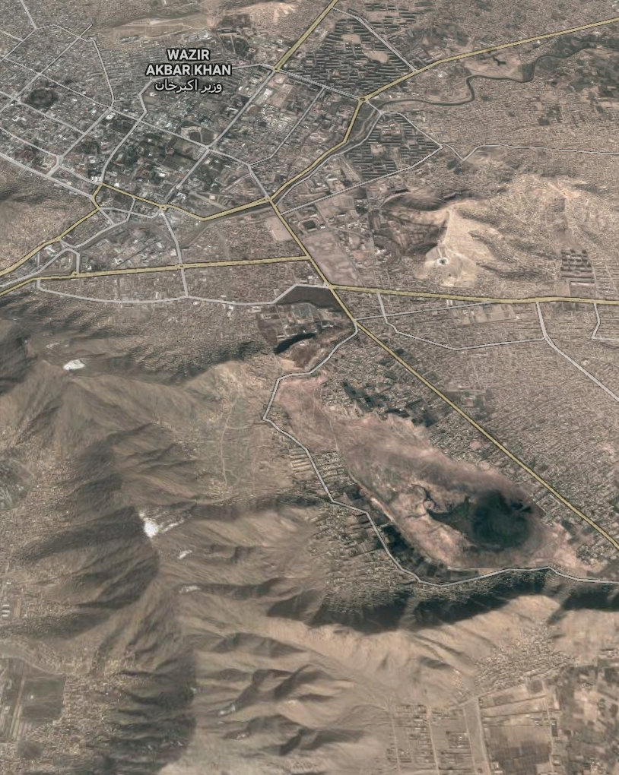



UAV
Make: General Atomics
Model: MQ-9 Reaper
IP: 198.241.17.212
Cell Tower
Operator: Etisalat
IP: 198.241.17.212
Status: Operational
Positive Match
Name: Abdul-Baser
Probability: 78%
Fingerprint:
Positive Match
Name: Abdul-Baser
Probability: 78%
Fingerprint:
HMMWV
Manufacturer: AM General
Model: XM1109
Speed: 113 km/h (max)

Slide 3

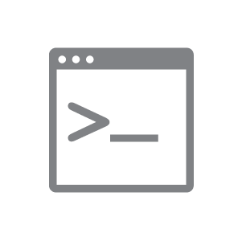
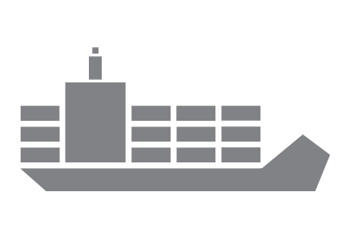












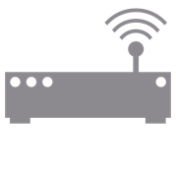
FILES &
FOLDERS
LEGACY FILE APPS
CONTAINER DATA
HADOOP & SPARK APPS
MACHINE/DEEP LEARNING
BI APPS
WEB
APPS
STREAMING APPS
Looks like a NAS
Distributed Analytics
Looks like a
SQL Engine
Looks like
Everything they need
Looks like
Kafka
APIs
NFS
POSIX
REST
HDFS
SQL
JSON
KAFKA
MapR Data Platform
MAPR CONVERGE-X™ DATA FABRIC
MAPR CONVERGE-X™ DATA FABRIC
ON-PREMISES, MULTI-CLOUD, IoT EDGE
IoT/Edge

Slide 4
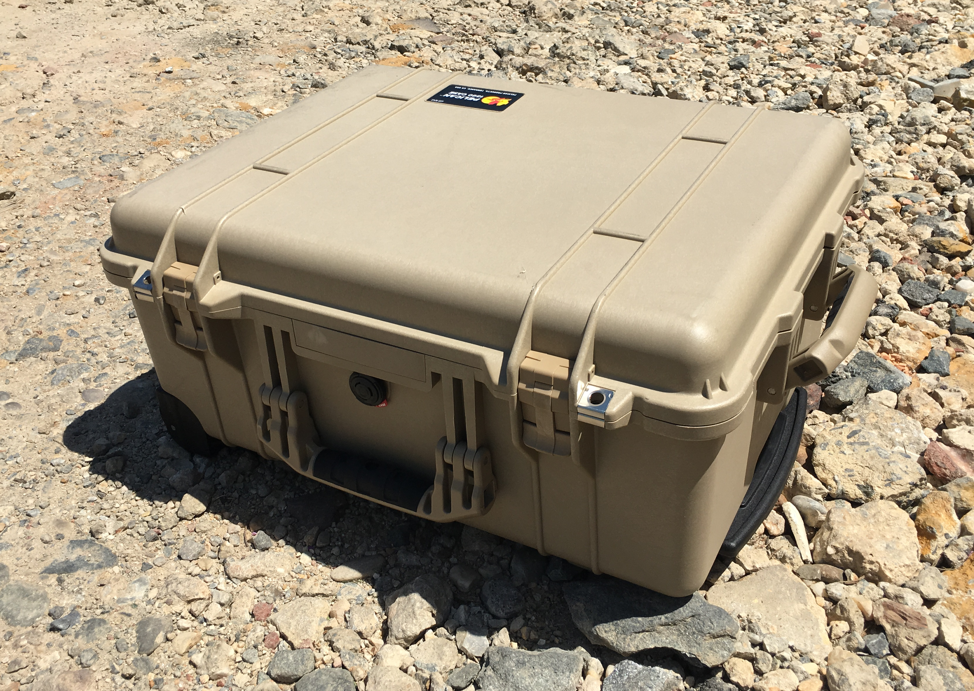
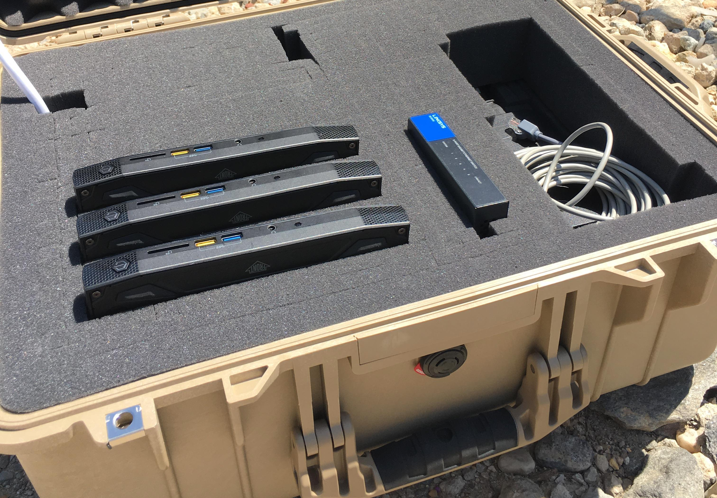
MapR at the EDGE
Mobile units operating in space-constrained locations require uncompromised computing power in a small footprint
Edge sites have slow or only occasionally connected network access, but data transfer is a must
Data collection is still producing large data volumes
MapR Edge is:
Fully redundant: a 3-5 node MapR cluster with built-in HA
Fully functional: files, database, streaming, data processing and analytics
Fully connected: file mirroring, table and stream replication
USE ANALYTICS TO PRIORITIZE DATA TRANSFERS
Algorithms will scale to data center size
Same tech at the Edge as in the Data Center
Notes:
MapR Edge is ideal for dealing with the characteristics of edge locations in industrial IoT environments. Data sources that create huge volumes of data such as oil rigs and vehicles are ideal environments for MapR Edge. Slow or occasionally connected sites can be managed by the bandwidth-aware replication in MapR. Space constrained locations that require a small computing footprint can be handled by MapR Edge, as it runs as a 3 to 5 node cluster on mini PCs such as the Intel NUCs, which are typically the size of a small book and can be bought off the shelf. Other vendors make similar PCs that are hardened for remote and even harsh locations as part of an IoT deployment.
Note: MapR is just software. Customer can choose suitable commodity hardware to meet their needs. SSD is interesting, because MapR has additional built-in optimizations for SSD, and SSDs have reliability benefits in extreme operating conditions.

Slide 5



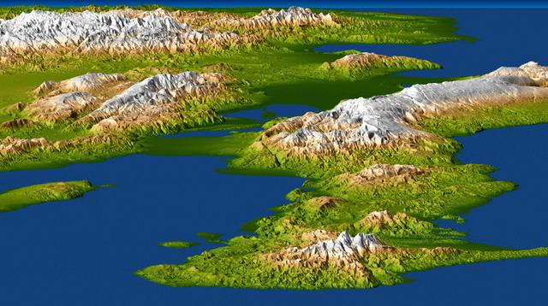
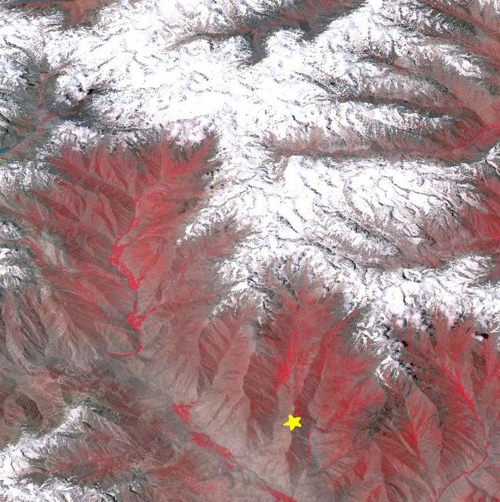
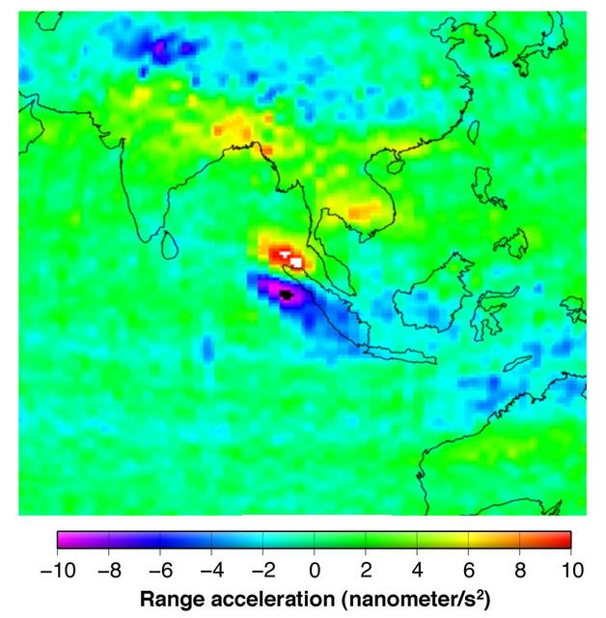
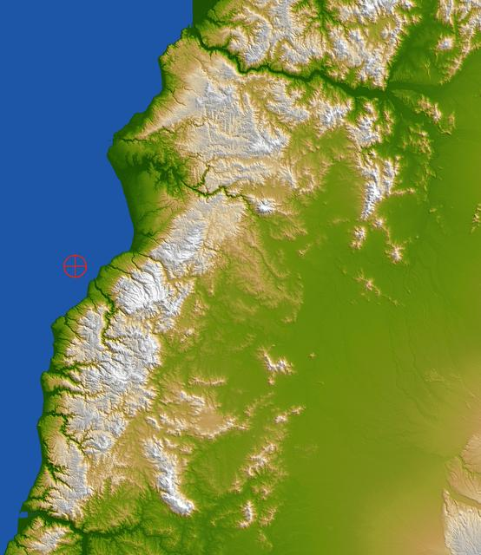

Real-Time Data Prioritization
Recommendation engines powered by Machine Learning and feedback loops
Regional HQ
Data Processing Pipeline
(Microservices)
Edge
Download
Categorize
Broadcast
Edge
Broadcast
/…/images
(file services)
/…/metaTable
(db services)
/…/repStream
(pub/sub services)
Request
/…/repStream
Microservices coordinated via messages published to:
Image
/…/images
/…/pipelineStream
Notes:
Preferred slide for explaining the demo. New images are being produced. A download service listens for new images and downloads them to MapR-FS (in /…/images). A Categorization service (optional) listens for the download event, runs the AWS Rekognition service, and updates the metadata record in MapR-DB. The Broadcast service also listens for the download event, and publishes a BROADCAST signal to the /…/repStream. repStream is replicated to the Edge. Soldiers request the images they want. Request events are published back to the repStream, which carries it back to HQ (multi-master replication). Requested images are conveyed to the Edge cluster via Mirroring.

Slide 6

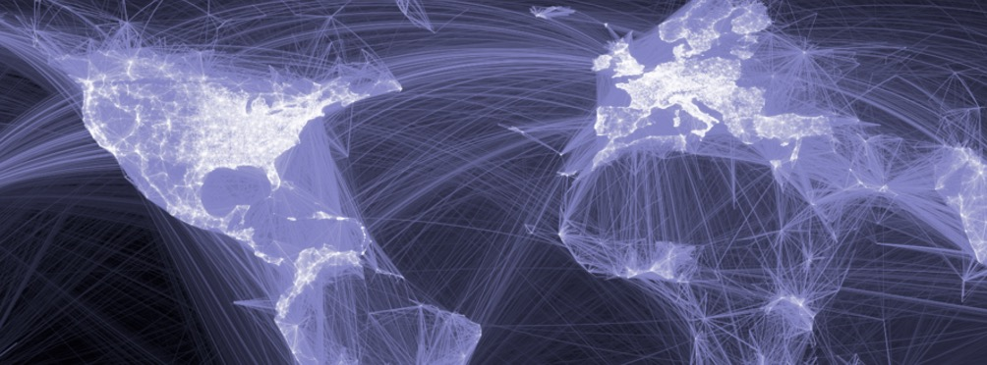





Real-Time Data Prioritization
Recommendations engines powered by Machine Learning and feedback loops
Data Operations Platform
Regional HQ
Edge
MapR-DB
Edge
Stream Processing
MapR-DB
Logistics Feeds
Analytic A
Topic
MapR-ES
Data Replication
Broadcast
Topic
Broadcast
Analytic B
MapR-XD
Equipment Health
MapR-XD
Topic
MapR-ES
Weather Events
Data Request
Data
Request
AI / Machine Learning Platform
Recommendation Engines
Notes:
Another way to illustrate the demo.

Slide 7

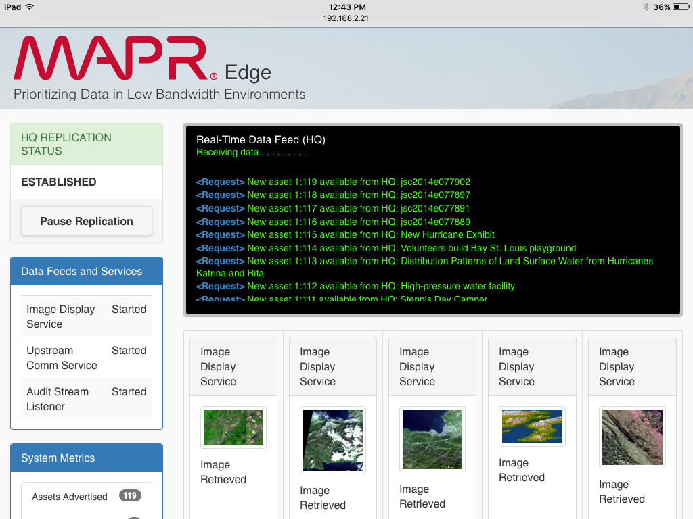
Notes:
Mobile devices can be connected to the Edge Dashboard via Wi-Fi (EDGENET).

Slide 8



MapR in Action: Agile Pipeline Development
Assemble pipelines, add new capabilities, and perform system upgrades with greater agility
μ2: v2 Classifier
μ1: Image Download Service
μ2: Image Classifier (v1)
NASA Data Feed
New Asset Available
New Image Downloaded
Image Categorized
Metadata record created in DB (JSON)
Image downloaded, stored to FS. DB record updated with file location.
Local file analyzed for content.
DB record updated with v1 category labels.
/v2
System Monitoring Messages (for Dashboard)
MapR Data Platform
Notes:
Here’s how the microservices work.

Slide 9
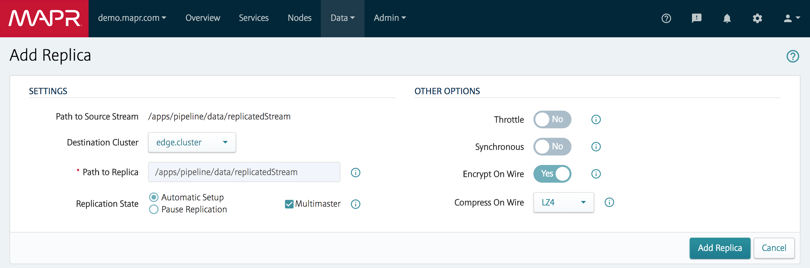
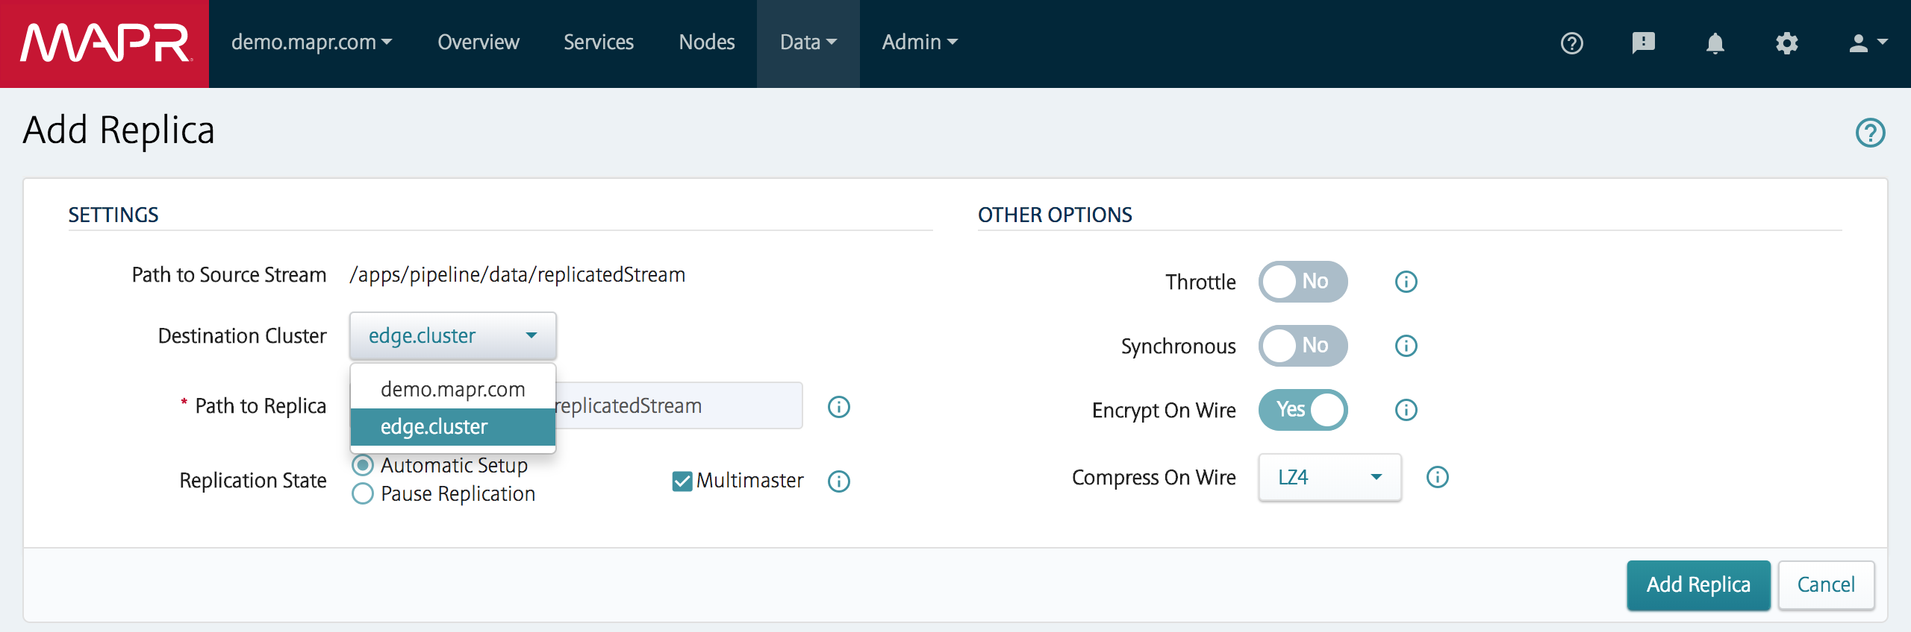
Push-Button Global Data Replication
Converged Data.
Global Namespace
Use Full Pipe
Where do you
want it?
Data ACKs,
Encryption,
Compression
Do Everything
Two-Way
Data Transfer
Manual Control,
or API-driven

Slide 10

DEMO

Slide 11
ADDITIONAL CONTENT

Slide 12
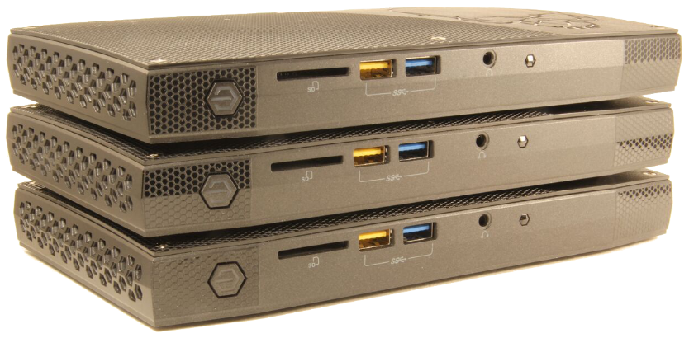




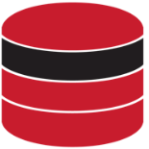






Data Where You Want It, Processing Where You Need It
File Mirroring, Table & Stream Replication, Advanced Topologies, Edge Computing
Aggregate and analyze data at the core
Computing power close to the data
Small footprint at the edge
Send insights back to edge
MAPR CONVERGED ENTERPRISE EDITION
MAPR EDGE
MAPR EDGE
[on-prem, hybrid, cloud]
Reliable replication
GLOBAL DATA PLANE (single namespace)
Convergence at the edge
Act locally, learn globally.
MAPR EDGE
Notes:
MapR’s converged data services and data replication technology leads to this: the ability to collect data anywhere it’s generated (at the edge), aggregate and analyze it centrally, and then redistribute the models back out the the edge. The edge refers to remote locations with limited bandwidth. Examples include the car companies (back to the initial customer examples) and medical device manufacturers.
You can speak to any of the topics in the subtitle: mirroring, active/active replication, global network topologies, edge computing.

Slide 13

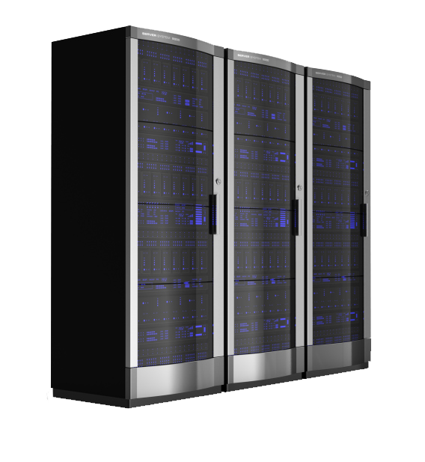







Data Replication Across a Global Namespace
Reliable, efficient data replication of all data types across any designated nodes
/loc1.enterprise.dcgs
/ship3.afloat.dcgs
/uav7.ship3.afloat.dcgs
MapR
Ashore
MapR
Afloat
MapR
Edge
/ship1/
/ship2/
/ship4/
/ship5/
/ship6/
/mission-data
/../../isr
/ship3/mission-data
Tables
Tables
Files
Streams
Files
Streams
*notional architecture*
Notes:
Replication is core to the platform.
Converged.
Works in limited-bandwidth environments. Enables the Edge.

Slide 14



Global Data Replication
Built-in Loop Detection
An Analytics-Ready Global Data Fabric
Vs:
DistCP
MirrorMaker
Custom Verification Tools
Etc.
Replication
Chaining
Replicate to
64 Destinations
File Mirroring
Active/Active Table & Stream Replication
Minutes to Implement
Set and Forget
Handled by the Platform
Notes:
From “Top 10 misconceptions of migrating to cloud”:
#1 – Copying data to the cloud is easy.
DistCP requires pretty serious tuning and continuous scheduling, also not all versions of DistCP allow you to blacklist/whitelist objects.
MirrorMaker requires proper tuning and visibility (metrics export via JMX) in order to be able to measure its stability, performance, and consumer lag.
Verification of that data in the Cloud object store is even harder and in certain cases requires some custom tooling. For example, a custom data catalogue with object name hashes or something similar.

Slide 15
NETWORK CONFIGURATIONS

Slide 16




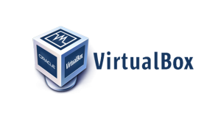
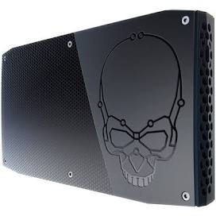
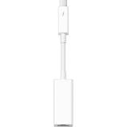
Edge Networking
With Wireless Router
Edge
DHCP
192.168.1.175
Dynamic - changes with the network
edge1.enterprise.org
Outbound Internet Access
6.1
edge1.mapr
192.168.2.21
NAT
10.0.2.15
Bi-Directional Data Replication
192.168.2.1
Wireless Router
4-Ports, SSID: EDGENET
192.168.2.100
Thunderbolt Ethernet (en6)
Bridged Adapter to en6
192.168.2.50
No Internet Access
6.1
edge2.mapr
192.168.2.22
6.1 Sandbox
Cluster: dc1.enterprise.org
Machine: maprdemo.local
6.1
edge3.mapr
192.168.2.23
Notes:
Current networking, using a 4-port Wireless Router. Wireless devices can join the EDGENET Wi-Fi network.

Slide 17


Sandbox-to-Cloud Networking
VPC: vpcGlobalDataFabric (10.10.0.0/16)
Route Table: rtGlobalDataFabric
10.10.0.0/16 | local
0.0.0.0/0 | igwGlobalDataFabric
10.8.0.0/24 | OpenVPN Instance
x.x.x.x (Internal IP)
Dynamic - changes with the network
Subnet: snGlobalDataFabric (10.10.10.0/24)
6.1
aws1.enterprise.org
RHEL 7.4
R4.xlarge
10.10.10.221 (*)
SG: sgMapRNodes
RHEL 7.4
t2.micro
10.10.10.248
10.8.0.1 (VPN)
SG: sgOpenVPN
IP forwarding enabled
Source/Destination check disabled
Bi-Directional Data Replication
Internet Gateway: igwGlobalDataFabric
52.200.25.223 (Elastic IP)
6.1 Sandbox
NAT: 10.0.2.15
VPN: 10.8.0.2
Routable to/from 10.10.10.0/24
OpenVPN Tunnel
Security Groups | sgOpenVPN | Allow UDP 1194 from anywhere. Allow TCP 22 from office. Allow all traffic from sgMapRNodes.
 | sgMapRNodes | Allow required MapR admin ports from office/anywhere. Allow all traffic from sgOpenVPN, sgMapRNodes.
(*) This internal IP address will be used for cross-cluster replication.
Assign a public IP address if you want internet access for this node.
Barring some other strategy, Internet is required for software installation and remote management.
Also, the demo (optionally) downloads images from NASA and leverages AWS Rekognition.
Notes:
Enable IP Forwarding on the OpenVPN server, to allow traffic from the Sandbox to the the AWS subnet to flow through the Open VPN server, and vice versa. Issue the following command:
sysctl net.ipv4.ip_forward=1
To enable this permanently, add the following line to /etc/sysctl.conf:
net.ipv4.ip_forward = 1
Also, Source/Destination check has to be disabled on the OpenVPN server. From the AWS console, select the instance and navigate to Actions > Networking > Change Source/Dest. Check

Slide 18

Multi-Cloud Networking
VPC: vpcGlobalDataFabric (10.10.0.0/16)
using OpenVPN
Route Table: rtGlobalDataFabric
10.10.0.0/16 | local
0.0.0.0/0 | igwGlobalDataFabric
10.8.0.0/24 | OpenVPN Instance
10.11.11.0/24 | OpenVPN Instance
Resource Group: rgGlobalDataFabric
Virtual Network: vnGlobalDataFabric (10.11.0.0/16)
Route Table: rtGlobalDataFabric
10.8.0.0/16 | OpenVPN Instance
10.10.10.0/24 | OpenVPN Instance
Subnet: snGlobalDataFabric (10.10.10.0/24)
6.1
aws1.enterprise.org
RHEL 7.4
R4.xlarge
10.10.10.221 (*)
SG: sgMapRNodes
RHEL 7.4
t2.micro
10.10.10.186
10.8.0.1 (VPN)
SG: sgOpenVPN
IP forwarding enabled
Source/Destination check disabled
Internet Gateway: igwGlobalDataFabric
Subnet: snGlobalDataFabric (10.11.11.0/24)
Bi-Directional Data Replication
RHEL 7.4
D2_v3
10.11.11.4 10.8.0.3 (VPN)
SG: sgOpenVPN
IP forwarding enabled
IP forwarding enabled (Azure)
6.1
azure1.enterprise.org
RHEL 7.4
E4-2s_V3
10.11.11.5 (*)
SG: sgMapRNodes
52.200.25.223 (Elastic IP)
23.96.106.251
(Public Static IP)
OpenVPN Tunnel
Security Groups | sgOpenVPN | Allow UDP 1194 from anywhere. Allow TCP 22 from office. Allow all traffic from sgMapRNodes.
 | sgMapRNodes | Allow required MapR admin ports from office/anywhere. Allow all traffic from sgOpenVPN, sgMapRNodes.
(*) These internal IP addresses will be used for cross-cluster replication.
Assign public IP addresses if you want internet access for this node.
Barring some other strategy, Internet is required for software installation and remote management.
Also, the demo (optionally) downloads images from NASA and leverages AWS Rekognition.
Notes:
Enable IP Forwarding on the OpenVPN server, to allow traffic from the Sandbox to the the AWS subnet to flow through the Open VPN server, and vice versa. Issue the following command:
sysctl net.ipv4.ip_forward=1
To enable this permanently, add the following line to /etc/sysctl.conf:
net.ipv4.ip_forward = 1
Source/Destination check has to be disabled on the OpenVPN server. From the AWS console, select the instance and navigate to Actions > Networking > Change Source/Dest. Check

Slide 19

Multi-Cloud Networking
Resource Group: rgGlobalDataFabric
IPSec using StrongSwan and Azure-Managed VPN
Virtual Network: vnGlobalDataFabric 10.11.0.0/16
Subnet: snGlobalDataFabric (10.11.11.0/24)
VPC: vpcGlobalDataFabric (10.10.0.0/16)
azure1.enterprise.org
10.11.11.5 (*)
SG: sgMapRNodes
RHEL 7.4
E4-2s_v3
Route Table | 0.0.0.0/16 | igwGlobalDataFabric
 | 10.11.0.0/16 | strongSwan
6.0.1
Subnet: snGlobalDataFabric (10.10.10.0/24)
Security Group | sgMapR: Allow ports 22, 8443, 9443, 8080, 8081 from office.
6.0.1
RHEL 7.4
R4.xlarge
10.10.10.251 (*)
aws1.enterprise.org
SG: sgMapRNodes
strongSwan VPN
RHEL 7.4
t2.micro
10.10.10.212
SG: sgStrongSwan
IP forwarding enabled
Source/Destination check disabled
Local Gateway
“awsVpnGW”
IP Address:
strongSwan IP
Address Space:
10.10.10.0/24
Internet Gateway: igwGlobalDataFabric
VPN Gateway
“azureVpnGW”
Gateway Subnet:
10.11.0.0/24
x.x.x.x (Elastic IP)
y.y.y.y (Public IP)
Site-to-Site
IPSec VPN
Connection
“azureVpnGW-awsVpnGW”
Site-to-Site (IPsec)
Shared Key: fabricTest123
Security Groups | MapRNodes | Allow all traffic from sgStrongSwanGW. Allow ports 22, 8443, 8080, and 8081 from office.
 | StrongSwan | Allow all traffic from sgMapRCluster and from azureVpnGW (y.y.y.y). Allow port 22 from office.
* MapR nodes require public IP addresses for installation and remote connectivity. Also, the demo (optionally) downloads images from NASA.
Notes:
This networking was based on a blog by Nick Amato.
I stopped using this approach for several reasons:
1. It’s very specific to Azure.
2. The costs add up. The Azure VPN Gateway costs $4.56/day, and you can’t just shut it down and restart it when you need it.
3. An alternative approach based on OpenVPN can be used in every scenario, and it works everywhere in a uniform way. You can shut it down when not in use.
The Azure side uses an Azure-managed VPN gateway service. That service requires its own Gateway subnet, which really has nothing to do with our design.
The AWS side does not use an AWS-managed VPN service. It uses strongSwan.
All Virtual Machines need internet access to install MapR software. Azure VMs get public IPs by default whereas AWS VMs do not.
Azure Security Groups, placed on individual NICs or the entire subnet, apply only to machines with public IP addresses.
The Azure E4-2s_v3 has 2 CPUs, 32 GB Ram, and costs $197.90/month (0.2660/hr).
The Azure free trial only allows 4 CPUs total.
Add 1 extra 20GB Standard HDD data disk for MapR.

Slide 20
Edge Networking
Edge
With 5-Port Ethernet Switch
192.168.1.175
Dynamic - changes with the network
edge.cluster
Outbound Internet Access
edge1.mapr
192.168.2.21
NAT
10.0.2.15
5-Port Ethernet Switch
Bi-Directional Data Replication
No Internet Access
edge2.mapr
192.168.2.22
192.168.2.100
Thunderbolt Ethernet (en6)
Bridged Adapter to en6
192.168.2.50
6.0 Sandbox
Machine: maprdemo.local
Cluster: demo.mapr.com
edge3.mapr
192.168.2.23
Notes:
Original networking configuration using a 5-port ethernet switch.
This was upgraded to a wireless router and 6.1.

Slide 21
Used in Video

Slide 22
Building a Global Data Fabric to the Edge

Slide 23
Regional HQ
Data Processing Pipeline
(Microservices)
Edge
Download
Categorize
Broadcast
Edge
Broadcast
/…/images
(file services)
/…/metaTable
(db services)
/…/repStream
(pub/sub services)
Request
/…/repStream
Microservices coordinated via messages published to:
Image
/…/images
/…/pipelineStream
Notes:
Preferred slide for explaining the demo. New images are being produced. A download service listens for new images and downloads them to MapR-FS (in /…/images). A Categorization service (optional) listens for the download event, runs the AWS Rekognition service, and updates the metadata record in MapR-DB. The Broadcast service also listens for the download event, and publishes a BROADCAST signal to the /…/repStream. repStream is replicated to the Edge. Soldiers request the images they want. Request events are published back to the repStream, which carries it back to HQ (multi-master replication). Requested images are conveyed to the Edge cluster via Mirroring.

Slide 24
Notes:
MapR Edge is ideal for dealing with the characteristics of edge locations in industrial IoT environments. Data sources that create huge volumes of data such as oil rigs and vehicles are ideal environments for MapR Edge. Slow or occasionally connected sites can be managed by the bandwidth-aware replication in MapR. Space constrained locations that require a small computing footprint can be handled by MapR Edge, as it runs as a 3 to 5 node cluster on mini PCs such as the Intel NUCs, which are typically the size of a small book and can be bought off the shelf. Other vendors make similar PCs that are hardened for remote and even harsh locations as part of an IoT deployment.
Note: MapR is just software. Customer can choose suitable commodity hardware to meet their needs. SSD is interesting, because MapR has additional built-in optimizations for SSD, and SSDs have reliability benefits in extreme operating conditions.

Slide 25



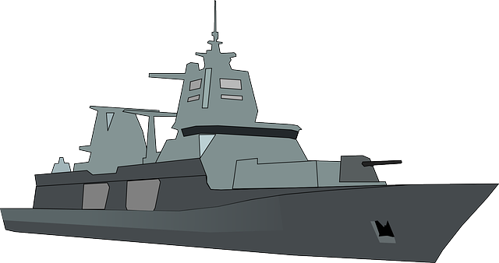

Deploying an Edge-to-Cloud Data Fabric with MapR
ML/AI
on information collected globally
Regional Fixed-Site Data Center
Broadcast
Tactical Edge
Request
Information Consumers running Mission Apps
Data Collection & Processing
Deliver
Notes:
So, we let our customers synchronize data across cloud providers. We leverage mirroring and replication to enable cloud neutrality.

Slide 26
